Slide 1
Restaurant multi-label classification by photo
Presented By :
Bechir Anoir CHABCHOUB
Mohamed BELLAKHAL
Supervised By :
Dr. Ferdaous Chaabane

Slide 2
1. Idea

Slide 3
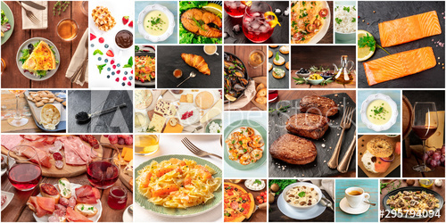
Restaurant classification by photo
Creating a Restaurant recommendation model based on old review photos
Giving to each restaurant a set of labels such as good for dinner, good for lunch, good for kids…

Slide 4
2. Project Pipeline

Slide 5

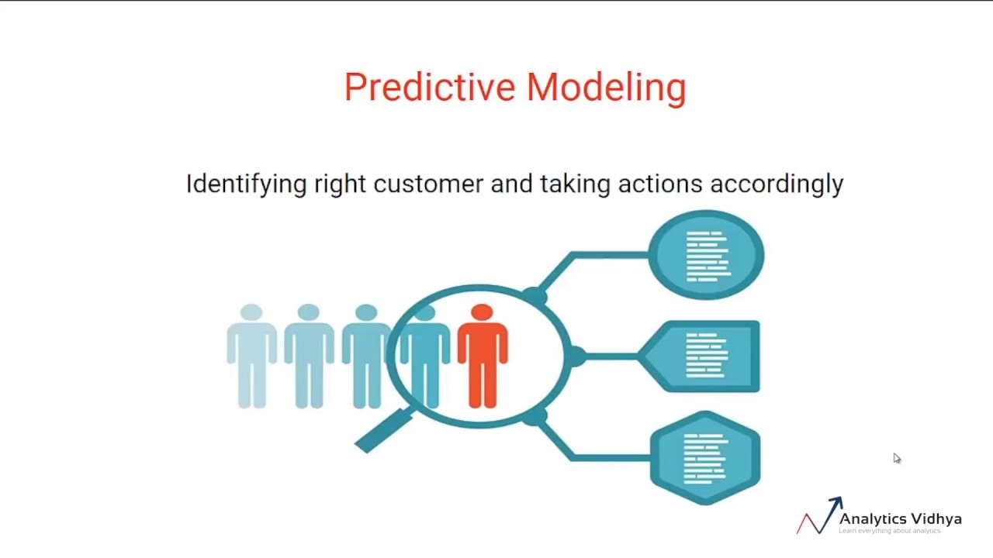
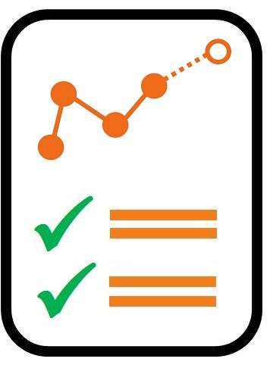
Data exploration and cleaning
1
Predictive Modeling and recommendation
2
Evaluation and results visualization
3

Slide 6
3. Data-set and data exploration

Slide 7
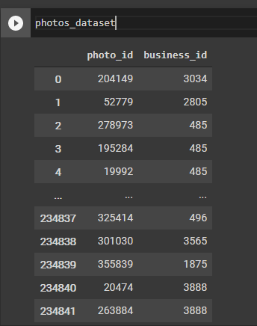
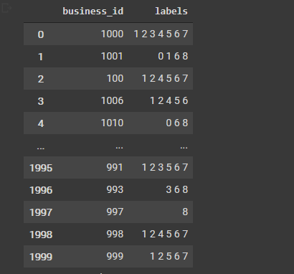
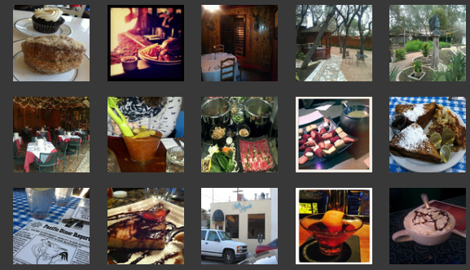
We used the YELP dataset from Kaggle
234842 samples of classified restaurant photos by the YELP community
Insight on the data :

Slide 8
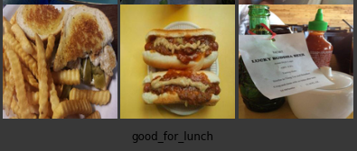
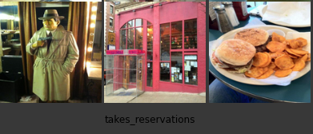
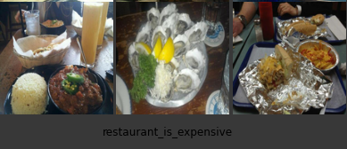
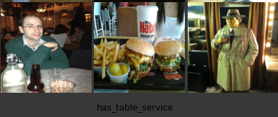

Slide 9
4. Model

Slide 10
Resnet 50
A convolutional neural network that is 50 layers deep
The pre-trained network can classify images into 1000 object categories
Resnet ➔ Detect objects in our images ➔ Assign each restaurant class to a specific set of objects
New Photo to test ➔
Objects extraction
➔ Labeled Photo

Slide 11
5. Evaluation

Slide 12




Slide 13
6. Final results and visualization

Slide 14
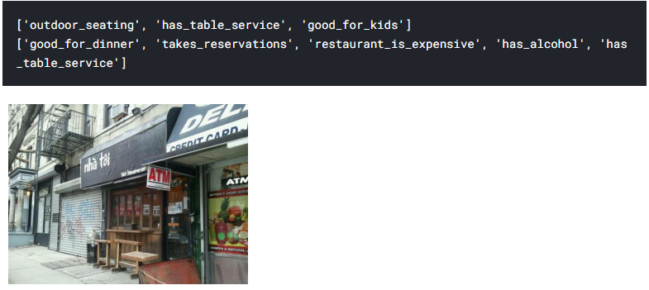
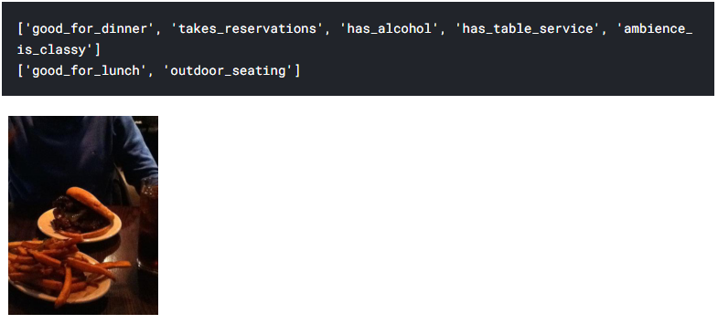
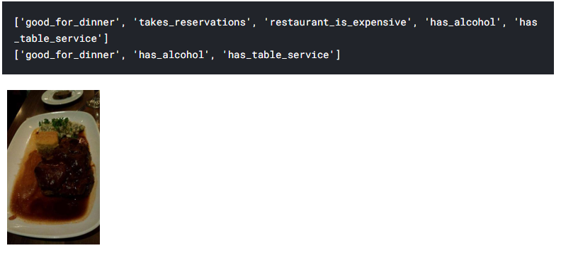

Slide 15
7. Self Tested Data

Slide 16
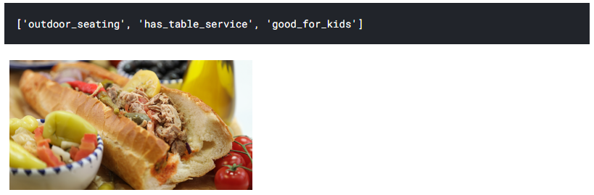
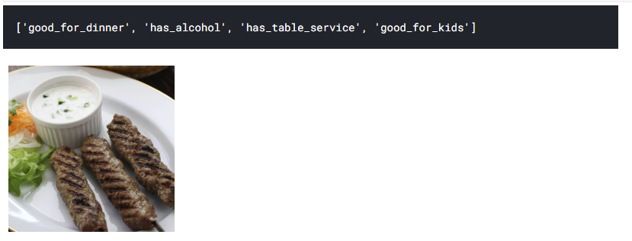
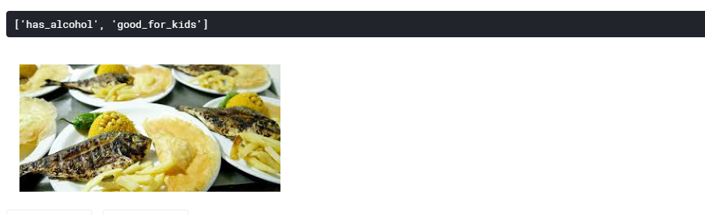

Slide 17

Thanks!
Any questions?

